Slide 1
Health Support
Integrazione dati sul web
A.A. 2016/2017
Christian Iodice Vincenzo Ceci

Slide 2
Problema - 1
Non ti senti bene? Hai qualche disturbo?
Oggi la maniera più naturale è sfruttare la potenza del Web per dare una risposta immediata ai propri disturbi prima di consultare un medico

Slide 3
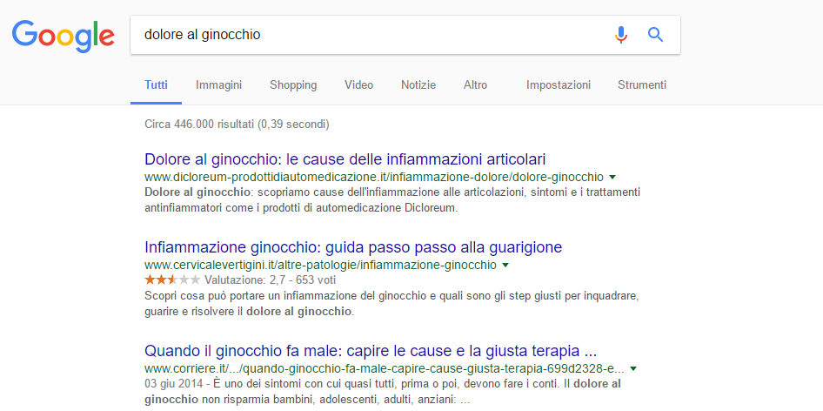
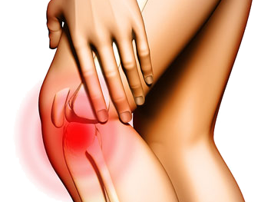
Problema - 2
Approccio classico
Ricerca del sintomo

Slide 4
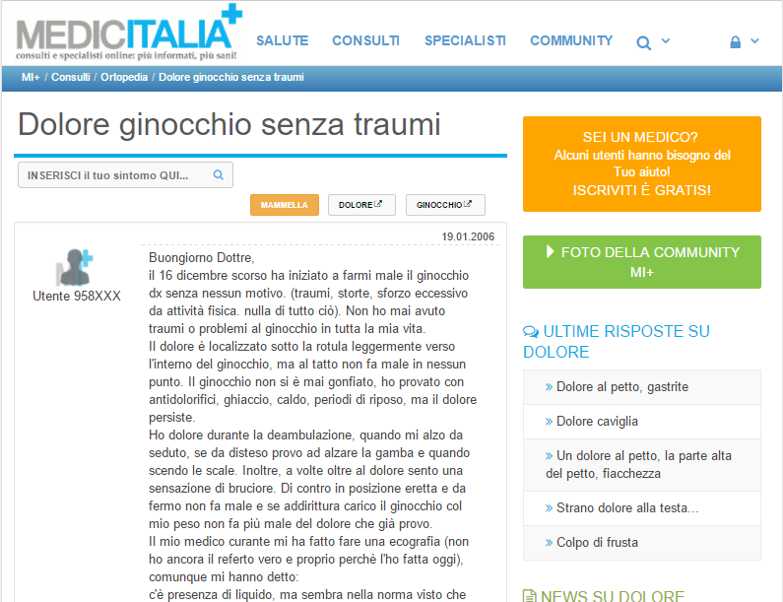
Problema - 3
Approccio classico
Ricerca pareri medici

Slide 5
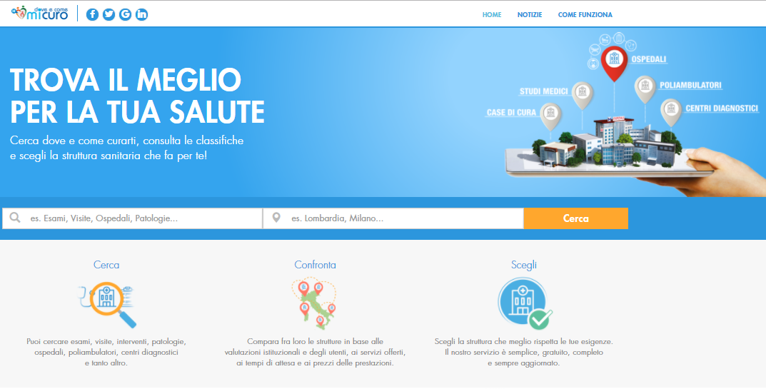
Problema - 4
Approccio classico
Ricerca cliniche

Slide 6
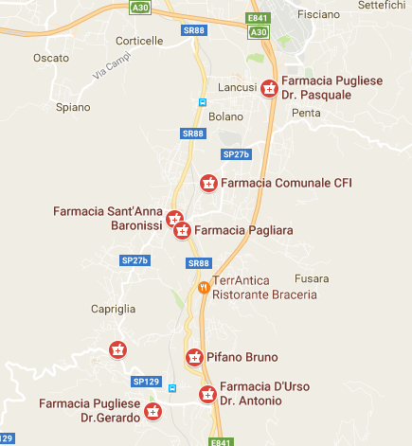
Problema - 5
Approccio classico
Ricerca farmacie

Slide 7
Problema - 6
Approccio classico
- Confusionario
- Complesso

Slide 8
Soluzione -1
Health Support è la soluzione
APPLICAZIONE WEB CHE SEMPLIFICA, VELOCIZZA E RAGGRUPPA IL TUTTO
Ricerca malattie da fonti affidabili tramite un semplice inserimento di sintomi
Con un click vieni a conoscenza di pareri medici
Ricerca le cliniche che curano la patologia individuata
Ricerca le farmacie più vicine a te

Slide 9
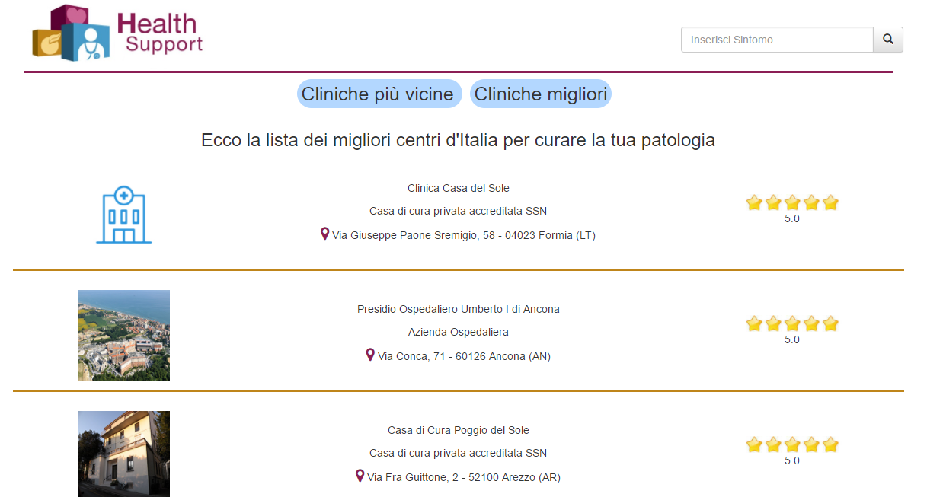
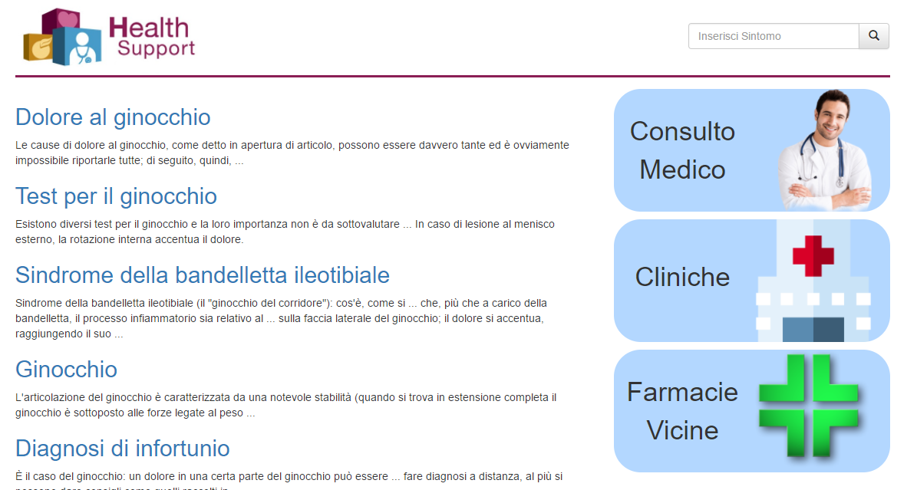
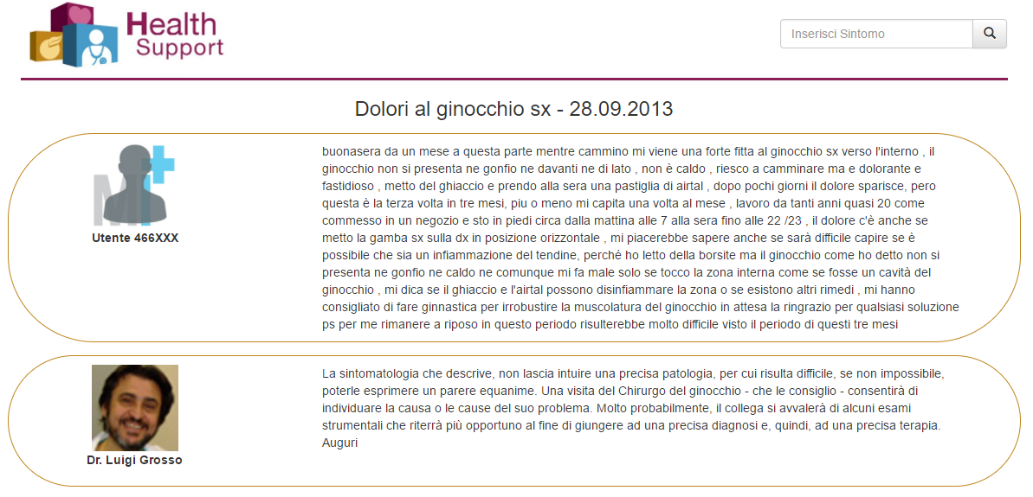
Soluzione - 2

Slide 10
Demo

Slide 11
Architettura
Mediator
Cache
Wrapper
Wrapper
Wrapper
Wrapper
Wrapper
fisioterapiarubiera.com
albanesi.it
doveecomemicuro.it
medicitalia.it
Google Maps

Slide 12
Le fonti
Nome | Metodo | Descrizione | Grado di volatilità
Fisioterapiarubiera | Web Scraping | sito di medicina che parla di malattie, sintomi, terapie, rimedi naturali, anatomia, diagnosi, dieta, alimentazione e sport. | Aggiornamento mensile
Albanesi | Web Scraping | Sito di medicina che si occupa di medicina, sintomi, farmaci ed esami, benessere e medicina alternativa. | Aggiornamento mensile
Doveecomemicuro | Web Scraping | Sito per cercare la struttura medica che meglio rispetta le tue esigenze. Confronta le strutture in base alle valutazioni istituzionali e degli utenti. | Aggiornamento mensile
Medicitalia | Web Scraping | Sito per di consulti medici online fatto da parte di medici esperti in qualsiasi ambito. | Aggiornamento mensile
Google maps | API | Una serie di strumenti per manipolare le mappe del globo terrestre messe a disposizione da Google Maps, con la possibilità di integrae nuovi servizi. | Aggiornamento continuo

Slide 13
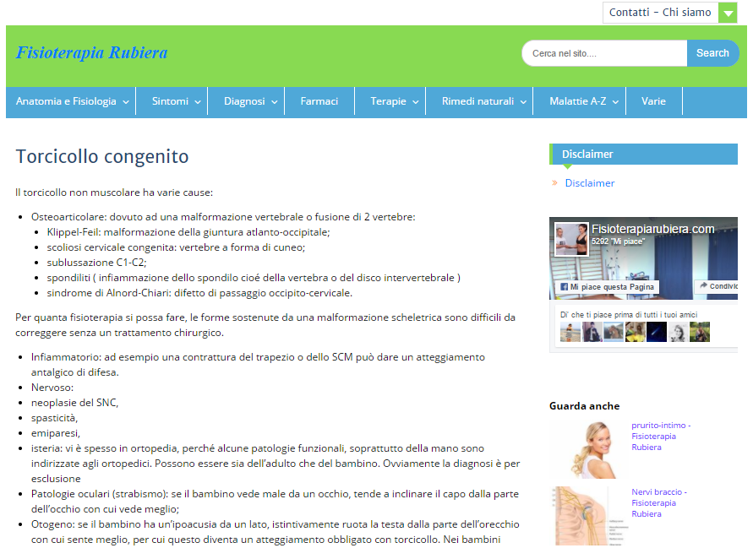
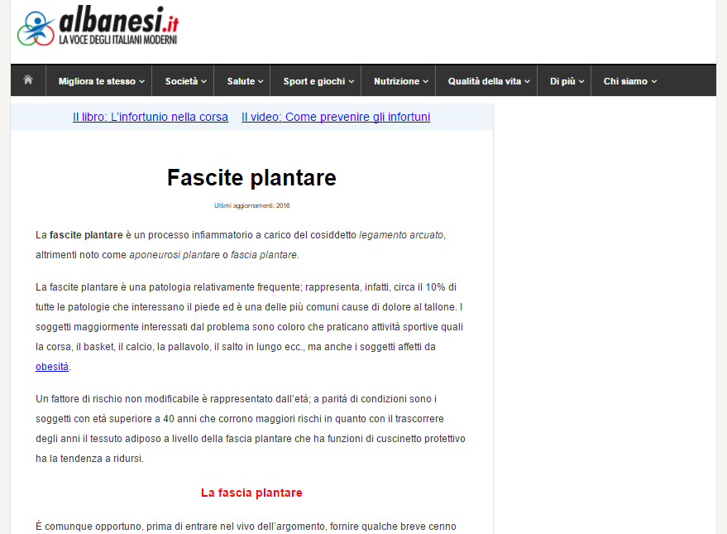
Le fonti locali - 1
Fisioterapiarubiera(FR)
result(title, description, link)
detail(title, images, description, paragraphs)
Indirizzo di ricerca: http://www.fisioterapiarubiera.com/?s=sintomo ¹
Albanesi (AL)
result(title, link, description)
detail(title, description, images, paragraphs)
Indirizzo di ricerca: http://www.google.it/search?q=albanesi.it+sintomo ¹
¹ sintomo chiave

Slide 14
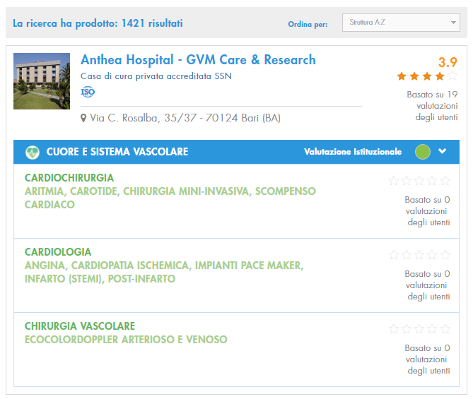
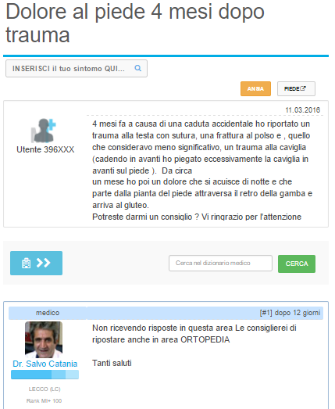
Le fonti locali - 2
Doveecomemicuro (DCMC)
hospital(name, description, image, address, star, id_symptom)
Indirizzo di ricerca: http://www.doveecomemicuro.it/strutture?q=sintomo¹
Medicitalia (ME)
result(title, link, short_description, id_symptom)
detail(title, user_image, doctor_image, question, answers, user_name, doctor_name)
Indirizzo di ricerca: http://www.google.it/search?q=medicitalia+sintomo¹
¹ sintomo chiave

Slide 15
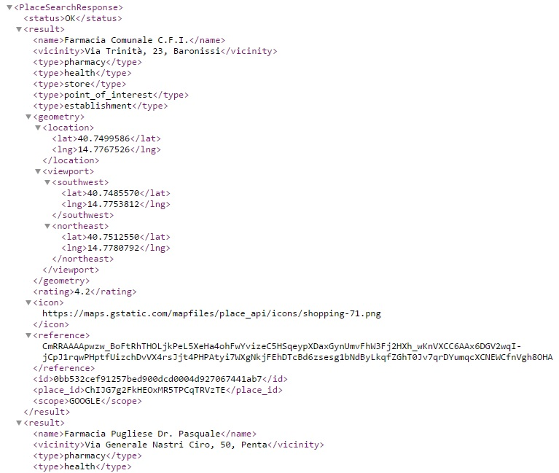
Le fonti locali - 3
GoogleMaps (GM)
result(name, vicinity, type, open_now, location_lat, location_lng)
Per trovare l’elenco delle farmacie nelle vicinanze è stata utilizzata l’ API di Google Maps: https://maps.googleapis.com/maps/api/place/nearbysearch/xml?location=LAT,LNG&radius=R&type=T&key=API_KEY
Dove:
location specifica la posizione attuale dell’utente attraverso l’inserimento delle coordinate (latitudine e longitudine)
Con radius si indica il raggio di ricerca
Type indica il luogo di interesse da ricercare
Key specifia l’API key utile per usufruire il servizio

Slide 16
Wrapper – fisioterapiarubiera
Per la ricerca del sintomo:
title: //main/article/header/h2/a[not(contains(.,"Fisioterapiarubiera.com"))]
link: //main/article/header/h2/a[not(contains(.,"Fisioterapiarubiera.com"))]/@href
description: //main/article[header/h2/a[not(contains(.,"Fisioterapiarubiera.com"))]]/div[@class="entry-summary"]
Per lo scaricamento delle informazioni di interesse:
title: //main/article/header[@class="entry-header"]
[image, description, paragraph]: //main[@id="main"]/article/div[@class="entry-content"]//*[self::p or self::img or self::li]

Slide 17
Wrapper – albanesi
Per la ricerca del sintomo:
title: //div[@class="g"]/h3[@class="r" and a[contains(@href,"albanesi.it/")]]
link: //div[@class="g"]/h3[@class="r"]/a[contains(@href,"albanesi.it")]/@href
description: //span[@class="st" and ./../../h3[@class="r"]/a/@href[(contains(.,"albanesi.it/"))]]
Per lo scaricamento delle informazioni di interesse:
title: //main/article/header[@class="entry-header"]
[description, images, paragraph]: //main[@class="content"]/article/div[@class="entry-content"]//*[self::p or self::img or self::li]

Slide 18
Wrapper – doveecomemicuro
Per la ricerca delle cliniche:
name: //h3[@class='underline']
description: //h4[@class='no-underline']/text()
address: //i[@class='fa fa-map-marker']/../text()
star: //div[@class='users-rating']/h3[1]/text()
image = //div[@class='single-health-facility table-info']//img[@class[contains(.,'img-responsive')]]/@src

Slide 19
Wrapper – medicitalia
Per la ricerca di pareri medici:
title: //div[@class="g"]/h3[@class="r"]/a[contains(@href,"consulti")]
link: //div[@class="g"]//h3[@class="r"]/a/@href[(contains(.,"consulti"))]
Short_description: //span[@class="st" and ./../../h3[@class="r"]/a/@href[(contains(.,"consulti"))]]
Per lo scaricamento delle informazioni di interesse:
[question, answer]: //div[@class="content" and @itemprop="text"]
[user_image, doctor_image]: //img[@class="img-rounded"]/@src
[user_name, doctor_name]: //span[@itemprop="author"]/span[@itemprop="name"]

Slide 20
Wrapper – Google Maps
Per la ricerca delle farmacie:
name: .find('name').text()
vicinity: .find('vicinity').text()
lat: .find('location').find('lat').text()
lng: .find('location').find('lng').text()
open_now: .find('opening_hours').find('open_now').text()

Slide 21
Schema Globale
symptom (title, short_description, link, images, long_description, paragraphs)
hospital (name, description, image, address, star, id_symptom)
consult (title, link, short_description, question, answers, user_image, doctor_image, user_name, doctor_name, id_symptom)
pharmacy (name, vicinity, type, open_now, latitude, longitude)

Slide 22
Mapping GAV - 1
symptom (title, short_description, link, images, long_description, paragraphs) :- FR.result (title, short_description, link) , FR.detail (title, images, long_description, paragraphs)
symptom (title, short_description, link, images, long_description, paragraphs) :- AL.result (title, link, short_description) , AL.detail (title, long_description, images, paragraphs)
hospital (name, description, image, address, star, id_symptom) :- DCMC.hospital(name, description, image, address, star, id_symptom) , FR.result (id_symptom, v1, v2)
hospital (name, description, image, address, star, id_symptom) :- DCMC.hospital(name, description, image, address, star, id_symptom) , AL.result (id_symptom, v1, v2)

Slide 23
Mapping GAV - 2
consult (title, link, short_description, question, answers, user_image, doctor_image, user_name, doctor_name, id_symptom) :- ME.result(title, link, short_description, id_symptom), ME.detail(title, user_image, doctor_image, question, answers, user_name, doctor_name) , FR.result (id_symptom, v1, v2)
consult (title, link, short_description, question, answers, user_image, doctor_image, user_name, doctor_name, id_symptom) :- ME.result(title, link, short_description, id_symptom), ME.detail(title, user_image, doctor_image, question, answers, user_name, doctor_name) , AL.result (id_symptom, v1, v2)
pharmacy (name, vicinity, type, open_now, latitude, longitude) :- GM.result(name, vicinity, type, open_now, latitude, longitude)

Slide 24
Mapping LAV
FR.result (title, short_description, link) :- symptom (title, short_description, link, v1, v2, v3)
FR.detail (title, images, long_description, paragraphs) :- symptom (title, v2, v3, images, long_description, paragraphs)
AL.result (title, link, short_description) :- symptom (title, short_description, link, v1, v2, v3)
AL.detail (title, long_description, images, paragraphs) :- symptom (title, v2, v3, images, long_description, paragraphs)
DCMC.hospital(name, description, image, address, star, id_symptom) :- hospital (name, description, image, address, star, id_symptom), symptom (id_symptom, v1, v2, v3, v4, v5)
ME.result(title, link, short_description, id_symptom) :- consult (title, link, short_description, v1, v2, v3, v4, v5, v6, id_symptom), symptom (id_symptom, v1, v2, v3, v4, v5)
ME.detail(title, user_image, doctor_image, question, answers, user_name, doctor_name) :- consult (title, v1, v2, question, answers, user_image, doctor_image, user_name, doctor_name, id_symptom) , symptom (id_symptom, v1, v2, v3, v4, v5)
GM.result(name, vicinity, type, open_now, latitude, longitude) :- pharmacy (name, vicinity, type, open_now, latitude, longitude)

Slide 25
Query - 1
Dato un sintomo, recuperare tutte le possibili diagnosi associate ad esso e gli ospedali specializzati nella cura della malattia relativa
findDiseaseWithHospital(title, images, description, paragraphs, hospital_name, hospital_description, hospital_image, address, star) :- symptom (title, v1, v2, images, description, paragraphs), hospital (hospital_name, hospital_description, hospital_image, address, star, title)
SELECT title, images, long_description as description, paragraphs, name as hospital_name, description as hospital_description, image as hospital_image, address, star
FROM symptom, hospital
WHERE symptom.title == hospital.id_symptom AND symptom.title = ‘occhi rossi’

Slide 26
Query - 2
Dato un sintomo, recuperare tutte le possibili diagnosi associate e i pareri medici inerenti ad esso
findDiseaseWithConsults (title_symptom, images, description, paragraphs, title_consult, user_image, doctor_image, question, answers, user_name, doctor_name) :- symptom (title_symptom, v1, v2, images, description, paragraphs), consult (title_consult, v1, v2, question, answers, user_image, doctor_image, user_name, doctor_name, title)
SELECT symptom.title as title_symptom, images, long_description as description, paragraphs, consult.title as title_consult, question, answers, user_image, doctor_image, user_name, doctor_name
FROM symptom, consult
WHERE symptom.title == consult.id_symptom AND symptom.title = ‘perdita di capelli’

Slide 27
Query - 3
Data una posizione espressa in latitudine e longitudine, recuperare le informazioni inerenti alle farmacie nelle vicinanze
findPharmacy (name, vicinity, open_now, latitude, longitude) :- pharmacy (name, vicinity, v1, open_now, latitude, longitude)
SELECT name, vicinity, open_now, latitude, longitude
FROM pharmacy
WHERE latitude=‘40.772108’ AND longitude=‘14.7906148’

Slide 28
GAV query unfolding - 1
findDiseaseWithHospital(title, images, description, paragraphs, hospital_name, hospital_description, hospital_image, address, star) :- symptom (title, v1, v2, images, description, paragraphs), hospital (hospital_name, hospital_description, hospital_image, address, star, title)
symptom è una unione di due query e quindi l’unfolding produce l’ OR tra findDiseaseWithHospital’ e findDiseaseWithHospital’’
findDiseaseWithHospital’(title, images, description, paragraphs, hospital_name, hospital_description, hospital_image, address, star) :- FR.result(title, v1, v2), FR.detail(title, images, description, paragraphs), DCMC.hospital(hospital_name, hospital_description, hospital_image, address, star, title), FR.result(title, v3, v4)
findDiseaseWithHospital’’(title, images, description, paragraphs, hospital_name, hospital_description, hospital_image, address, star) :- AL.result(title, v1, v2), AL.detail(title, description, images, paragraphs), DCMC.hospital(hospital_name, hospital_description, hospital_image, address, star, title), AL.result(title, v3, v4)

Slide 29
GAV query unfolding - 2
findDiseaseWithHospital(title, images, description, paragraphs, hospital_name, hospital_description, hospital_image, address, star) :- symptom (title, v1, v2, images, description, paragraphs), hospital (hospital_name, hospital_description, hospital_image, address, star, title)
hospital è una unione di due query e quindi l’unfolding produce l’ OR tra findDiseaseWithHospital’’’ e findDiseaseWithHospital’’’’
3. findDiseaseWithHospital’’’(title, images, description, paragraphs, hospital_name, hospital_description, hospital_image, address, star) :- FR.result(title, v1, v2), FR.detail(title, images, description, paragraphs), DCMC.hospital(hospital_name, hospital_description, hospital_image, address, star, title), AL.result(title, v3, v4)
4. findDiseaseWithHospital’’’’(title, images, description, paragraphs, hospital_name, hospital_description, hospital_image, address, star) :- AL.result(title, v1, v2), AL.detail(title, description, images, paragraphs), DCMC.hospital(hospital_name, hospital_description, hospital_image, address, star, title), FR.result(title, v3, v4)

Slide 30
GAV query simplification - 1
findDiseaseWithHospital(title, images, description, paragraphs, hospital_name, hospital_description, hospital_image, address, star) :- symptom (title, v1, v2, images, description, paragraphs), hospital (hospital_name, hospital_description, hospital_image, address, star, title)
findDiseaseWithHospital’(title, images, description, paragraphs, hospital_name, hospital_description, hospital_image, address, star) :- FR.result(title, v1, v2), FR.detail(title, images, description, paragraphs), DCMC.hospital(hospital_name, hospital_description, hospital_image, address, star, title), FR.result(title, v3, v4)
findDiseaseWithHospital’’(title, images, description, paragraphs, hospital_name, hospital_description, hospital_image, address, star) :- AL.result(title, v1, v2), AL.detail(title, description, images, paragraphs), DCMC.hospital(hospital_name, hospital_description, hospital_image, address, star, title), AL.result(title, v3, v4)

Slide 31
GAV query simplification - 2
findDiseaseWithHospital(title, images, description, paragraphs, hospital_name, hospital_description, hospital_image, address, star) :- symptom (title, v1, v2, images, description, paragraphs), hospital (hospital_name, hospital_description, hospital_image, address, star, title)
3. findDiseaseWithHospital’’’(title, images, description, paragraphs, hospital_name, hospital_description, hospital_image, address, star) :- FR.result(title, v1, v2), FR.detail(title, images, description, paragraphs), DCMC.hospital(hospital_name, hospital_description, hospital_image, address, star, title), AL.result(title, v3, v4)
4. findDiseaseWithHospital’’’’(title, images, description, paragraphs, hospital_name, hospital_description, hospital_image, address, star) :- AL.result(title, v1, v2), AL.detail(title, description, images, paragraphs), DCMC.hospital(hospital_name, hospital_description, hospital_image, address, star, title), FR.result(title, v3, v4)

Slide 32
LAV bucket algorithm - 1
Query:
findDiseaseWithHospital(title, images, description, paragraphs, hospital_name, hospital_description, hospital_image, address, star) :- symptom (title, v1, v2, images, description, paragraphs), hospital (hospital_name, hospital_description, hospital_image, address, star, title)
Primo step:
Si costruisce per ogni atomo g del corpo della query globale il suo bucket che ragruppa tutte le fonti locali da cui g può essere dedotto.
Bucket(symptom (title, v1, v2, images, description, paragraphs)):
FR.detail(title, images, description, paragraphs)
AL.detail(title, description, images, paragraphs)
Bucket(hospital (hospital_name, hospital_description, hospital_image, address, star, title)):
DCMC.hospital(hospital_name, hospital_description, hospital_image, address, star, title)
Notes:
Non abbiamo considerato fr.result perché non ha informazioni che devono essere mostrate in output, ovvero non ha la description, images e paragraphs.

Slide 33
LAV bucket algorithm - 2
Secondo step:
Consiste nel costruire una serie di query candidate che si ottengono combinando gli atomi di ogni bucket.
Sono possibili 2x1 riformulazioni:
findDiseaseWithHospital’(title, images, description, paragraphs, hospital_name, hospital_description, hospital_image, address, star) :- FR.detail(title, images, description, paragraphs), DCMC.hospital(hospital_name, hospital_description, hospital_image, address, star, title)
findDiseaseWithHospital’’(title, images, description, paragraphs, hospital_name, hospital_description, hospital_image, address, star) :- AL.detail(title, description, images, paragraphs), DCMC.hospital(hospital_name, hospital_description, hospital_image, address, star, title)
findDiseaseWithHospital’ non è inclusa in findDiseaseWithHospital’’ e viceversa per cui bisogna considerarle entrambe.

Slide 34
LAV bucket algorithm - 3
Terzo step:
Checking containement: tra tutte le query candidate considerare, se presente, la query che contiene massimamente tutte le altre e verificarne il suo contenimento nella query globale. Per fare questo bisogna riscrivere le query riformulate sulle fonti locali nuovamente sullo schema globale.
findDiseaseWithHospital’(title, images, description, paragraphs, hospital_name, hospital_description, hospital_image, address, star) :- FR.detail(title, images, description, paragraphs), DCMC.hospital(hospital_name, hospital_description, hospital_image, address, star, title)
findDiseaseWithHospital’’’(title, images, description, paragraphs, hospital_name, hospital_description, hospital_image, address, star) :- symptom (title, v1, v2, images, description, paragraphs), hospital (hospital_name, hospital_description, hospital_image, address, star, title)
findDiseaseWithHospital’’’ è identica a findDiseaseWithHospital, quindi sicuramente la query findDiseaseWithHospital’’’ è massimamente contenuta nella query globale iniziale.
Un risultato analogo si ha con findDiseaseWithHospital’’.

Slide 35
Tecnologie utilizzate

Slide 36
FINE

